Slide 1

The Overstrand Job Application User Guide
How to Register
Your Dashboard
Complete your Profile
Browse Jobs
View Job Details
Apply for a Job
Troubleshooting
Contact us: | Log a service requests via the Citizen App | Send an e-mail to enquiries@overstrand.gov.za |

Slide 2
How To Register
Go to the Overstrand Municipality website at www.overstrand.gov.za/vacancies
Select ‘Register’ if you do not have an account
Enter your email address, mobile number and create a password
Follow the prompts to verify your email address or enter the OTP sent to your mobile number to complete your registration
You can now sign in using your email address and password.
You will be taken to your Dashboard
Contact us: | Log a service requests via the Citizen App | Send an e-mail to enquiries@overstrand.gov.za |

Slide 3
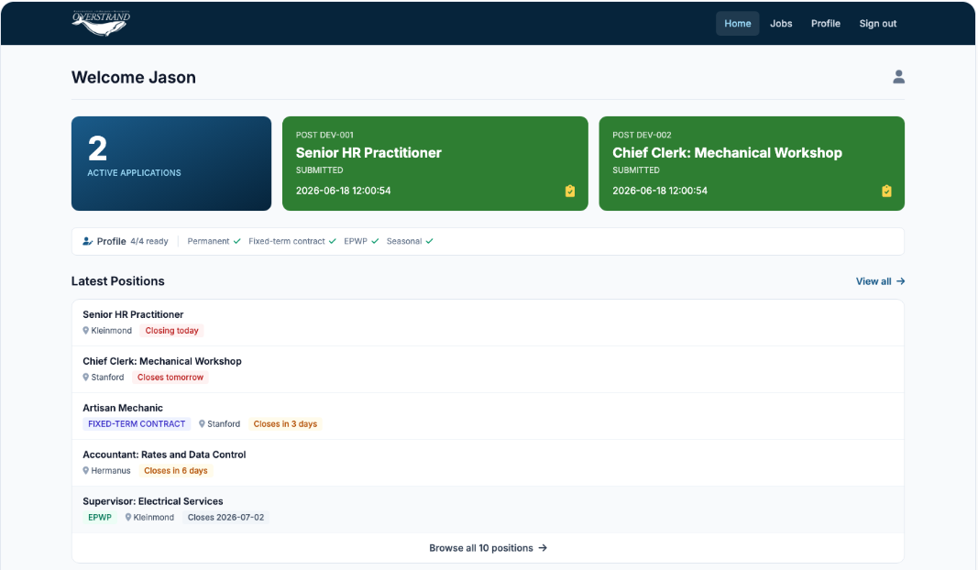
xxxxxx
Your Dashboard
(Example data used for purpose of illustration)
Contact us: | Log a service requests via the Citizen App | Send an e-mail to enquiries@overstrand.gov.za |

Slide 4
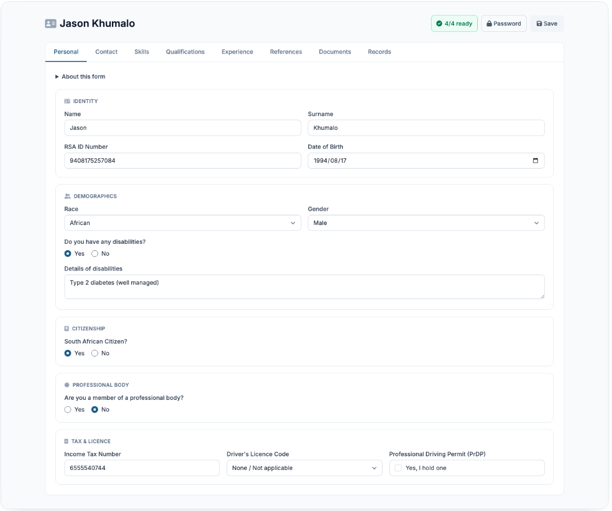
Complete your Profile
Your Name
xxxxxx
xxxxxx
xxxxxx
xxxxxx
Open your Profile.
Proceed to complete your profile.
Complete all sections required for your profile.
Headers indicate which section is currently
being completed.
5. Save each section before moving on.
xxxxxx
xxxxxx
xxxxxx
xxxxxx
xxxxxx
xxxxxx
Contact us: | Log a service requests via the Citizen App | Send an e-mail to enquiries@overstrand.gov.za |

Slide 5
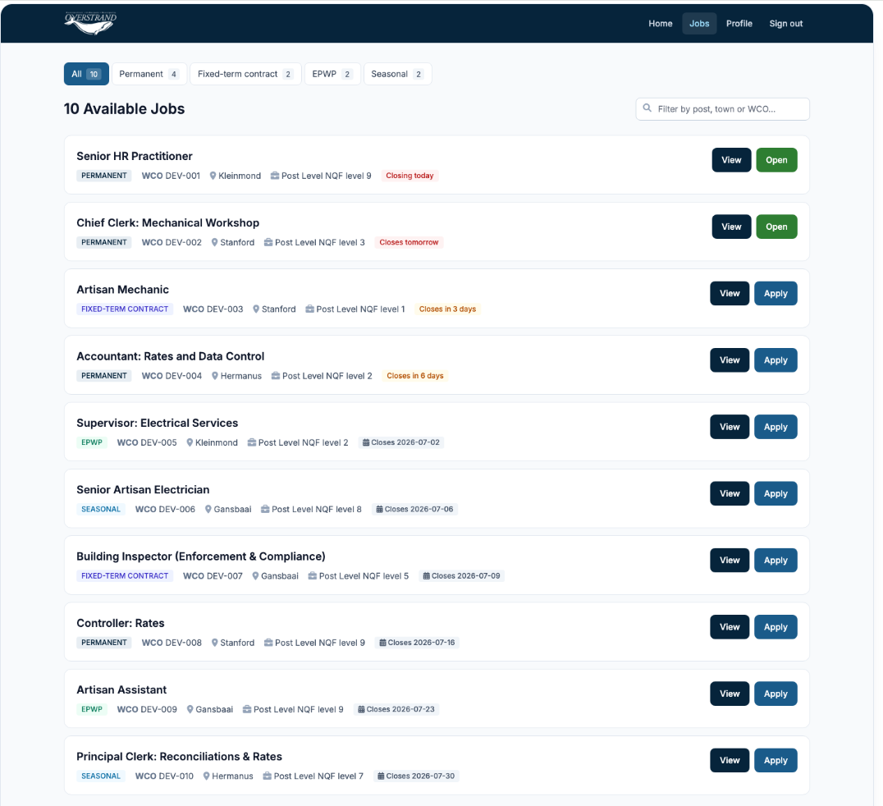
Browse Jobs
(Example data used for purpose of illustration)
Open up ‘Available Jobs’.
View the available jobs.
Open the job you want to apply for.
Contact us: | Log a service requests via the Citizen App | Send an e-mail to enquiries@overstrand.gov.za |

Slide 6
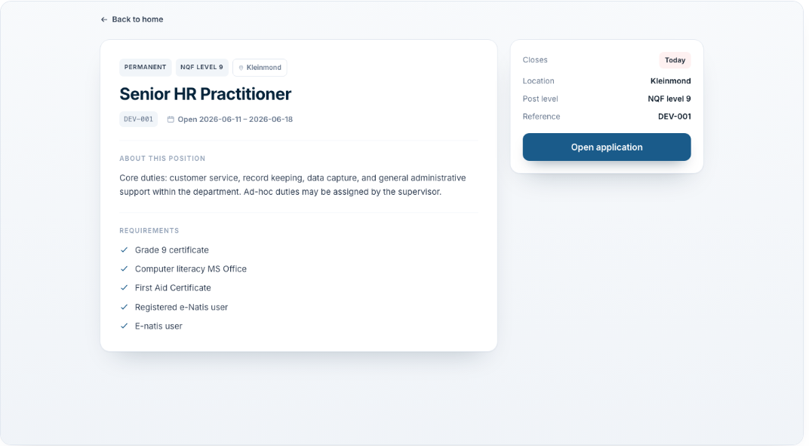
View Job Details
(Example data used for purpose of illustration)
Contact us: | Log a service requests via the Citizen App | Send an e-mail to enquiries@overstrand.gov.za |

Slide 7
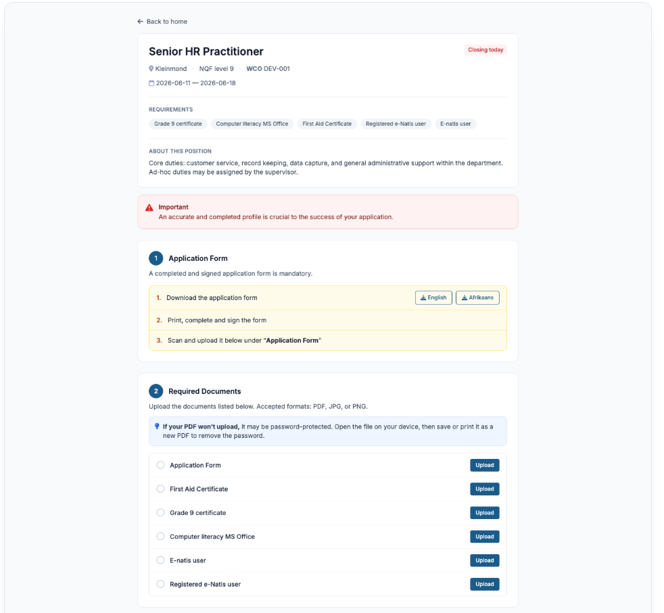
Apply for a Job
Download, complete and sign the application form (scan when done).
Upload each required document.
Submit the application before the closing date.
Contact us: | Log a service requests via the Citizen App | Send an e-mail to enquiries@overstrand.gov.za |

Slide 8
Cannot sign in?
Confirm that you are using the correct email address.
Check for typing mistakes.
Use Forgot Password if you cannot remember the password.
Log a service request on the Citizen app and we will assist you.
Did not receive OTP or email?
Confirm the email address or mobile number is correct.
Check your spam or junk mail.
Wait a few minutes and try again.
If the message still does not arrive, contact us with your email address and time of the attempt.
Troubleshooting
Contact us: | Log a service requests via the Citizen App | Send an e-mail to enquiries@overstrand.gov.za |

Slide 9
Profile is incomplete
Open your Profile.
Check each section for missing required fields.
Save the section after editing.
Return to the job application after the profile is complete.
Cannot upload a document
Confirm the file is a supported document or image.
Confirm the file is readable.
Try a smaller file if the upload fails.
Try again with a stable internet connection.
If the upload still fails, contact us with your email, job reference, and document type.
Troubleshooting
Contact us: | Log a service requests via the Citizen App | Send an e-mail to enquiries@overstrand.gov.za |

Slide 10
Started but did not submit
Sign in and return to the job.
Complete missing requirements and submit before the closing date.
Common mistakes
Using a different email address from the one used to register.
Leaving profile sections incomplete.
Uploading unclear photos or unreadable documents.
Starting an application but not submitting it.
Applying close to the deadline and running out of time.
Troubleshooting
Contact us: | Log a service requests via the Citizen App | Send an e-mail to enquiries@overstrand.gov.za |

