Slide 1
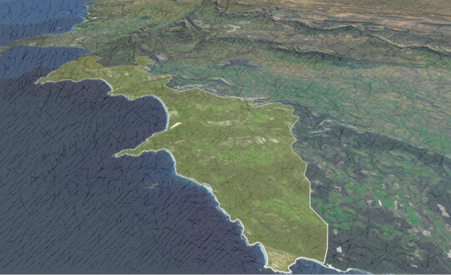
OVERSTRAND INTEGRATED DEVELOPMENT FRAMEWORK
Overstrand Toward 2050
PRESENTATION TO INTERESTED AND AFFECTED PARTIES
31 OCTOBER 2012

Slide 2
WELCOME
Presentation by Paul Olden: Urban Dynamics Western Cape
Welcome
Introduction of Project Team
Attendance Register

Slide 3
AGENDA
Purpose of the Presentation & Workshop
Why do we Need the Integrated Development Framework (IDF)
IDF Specific Objectives
IDF Development Methodology
IDF Policy Framework
IDF in the Spatial Planning Context
IDF Public Participation Process
Our Overstrand – Situational Analysis
Key Challenges Facing the Overstrand and its Impacts
Workshop Session

Slide 4
PURPOSE OF PRESENTATION & WORKSHOP
INFORMATION SHARING
  Provide background on the IDF project .
  Present the IDF concept, need, goals and function.
  Brief overview of the Overstrand municipal area:
    Its people;
    Economy;
    Natural, rural and urban environments;
    Infrastructure.
  Broad overview of the Key Challenges facing the Overstrand.
PUBLIC INPUT
  Gather input in identifying key challenges/threats.

Slide 5

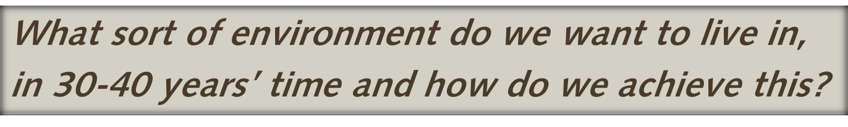
KEY QUESTION

Slide 6
WHY DO WE NEED THE IDF?
No formal long term planning mechanism for future sustainable spatial growth and development.
Short term planning must be consistent with achieving medium-long term goals.
Current policy framework:
    Fragmented and incoherent;
    Complicates planning, decision making and management.
The IDF will contribute to transforming the current policy framework into one that is integrated, coherent, strategic and user friendly.
IDF addresses key challenges re the Overstrand’s urban, rural and natural environments.

Slide 7
IDF SPECIFIC OBJECTIVES
Compile a strategic user friendly summary document that integrates and references all municipal plans, strategies and programmes related to the Overstrand’s long term integrated spatial vision and policies.
Product must ensure that the 5 year IDP budgetary planning is aligned with the 30-40 year integrated spatial vision.
Deliverable must provide a clear strategic development & environmental management framework.

Slide 8
IDF SPECIFIC OBJECTIVES
Continued
IDF must identify the key medium to long term strategic challenges and impacts that are facing the Overstrand.
Strategic thresholds and acceptable limits of environmental change must be clearly established.
The deliverables must include:
  An Environmental Management Framework (EMF)
  A Human Settlement Plan (HSP)
  Strategic update/review of existing SDF
  IDF document

Slide 9

IDF DEVELOPMENT METHODOLOGY
Phases 1-3
Phase 4
Phase 5
Phase 6
ANALYSIS
POLICY FORMAT
SPATIAL COMPONENT
IMPLEMENTATION
Consultation with Government Officials
Consultation with Interested and Affected Parties
Determine Status Quo and identify challenges
Formulating our 2050 Integrated Spatial Vision
Providing Strategic Directives guiding us towards realising the above
Integrating the 5 year IDP and long term (2050) planning
Integrated Development and Conservation Framework
Provides spatial direction toward 2050
Addresses challenges identified during analysis phase
Current and proposed action plans:
Goals:
Addressing challenges
Working toward realising our 2050 Integrated Spatial Vision

Slide 10
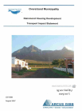
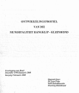

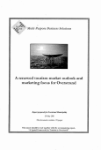
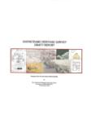
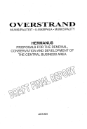


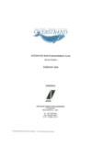

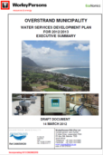
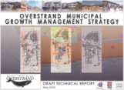

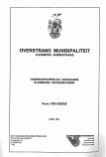
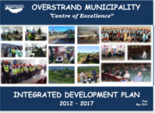
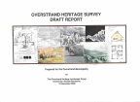
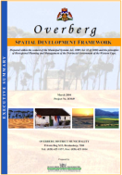
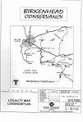

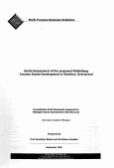
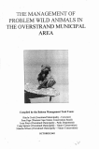

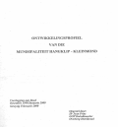
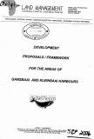

THE CURRENT POLICY FRAMEWORK
OVERSTRANDHSP
OVERSTRAND
Environmental Management Framework

Slide 11
IDF POLICY FRAMEWORK
KEY QUESTION
7 STRATEGIC DIRECTIVES provide the Strategic Policy Framework

Slide 12
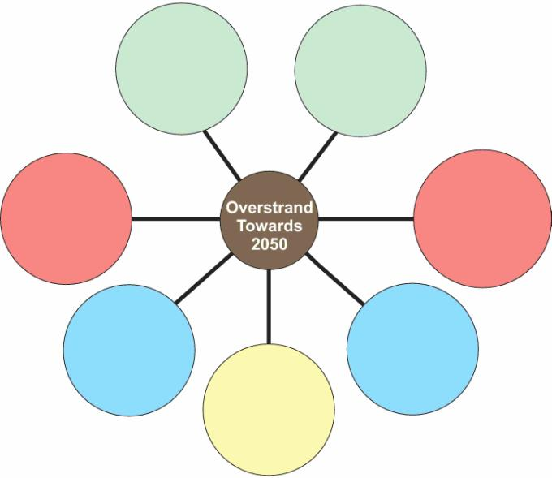
STRATEGIC DIRECTIVES
A liveable Overstrand
An environmentally sustainable and resilient Overstrand
An Overstrand structured by adequate service infrastructure
An accessible and connected Overstrand
Vibrant and exciting urban areas
A memorable and distinctive Overstrand
An Overstrand that enables a prosperous and diverse economy

Slide 13





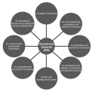







IDF IN THE PLANNING CONTEXT
NATIONAL PROVINCIAL DISTRICT LOCAL
OVERSTRANDHSP
IDF
LONG TERM
VISION
IDP
5 YEAR PLAN
NATIONAL SDP
PROVINCIAL SDF
OVERSTRAND MUNICIPAL SDF
OVERBERG SDF
OVERSTRAND
Environmental Management Framework
IMPLEMENTATION MECHANISMS
URBAN DYNAMICS WESTERN CAPE

Slide 14
IDF PUBLIC PARTICIPATION PROCESS
PHASE 1: PUBLIC MEETING – 31 October 2012
  Information sharing.
  Purpose: Gather input on the Key Challenges facing the Overstrand.
  Requests for inputs to inform IDF.
PHASE 2: PUBLIC WORKSHOP – June 2013
  Draft IDF to be advertised for comments.
  Public workshop with purpose of gathering comments on
  Draft IDF.
  Comments will be analysed and IDF revised where relevant - prior to submission to Council.

Slide 15
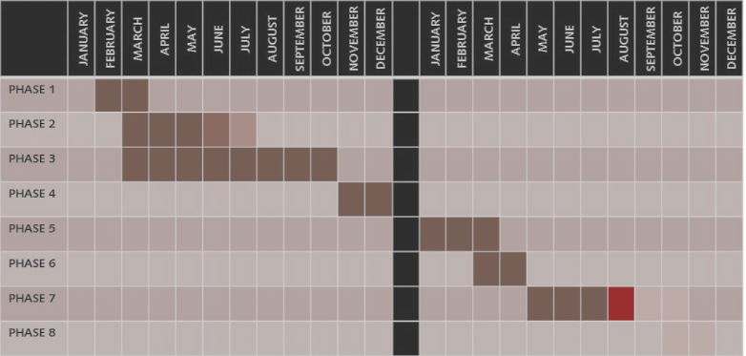
IDF PUBLIC PARTICIPATION PROCESS
PUBLIC PARTICIPATION

Slide 16
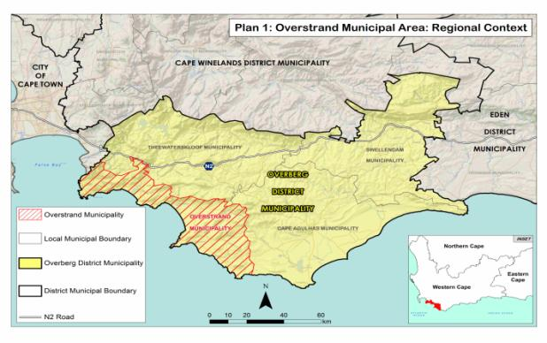
OUR OVERSTRAND
SITUATIONAL ANALYSIS

Slide 17
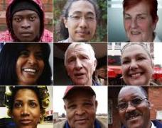
OUR PEOPLE
-A BROAD OVERVIEW –

Slide 18
OUR PEOPLE
POPULATION
Overstrand Municipal Area 2010 population estimate:
87 747 / 31 000 households.
Population growth in past two years - 5.58% per annum.
Population growth - third highest in the Western Cape Province.
Bulk of in-migration to the Overstrand region from the Eastern Cape Province.
Increasingly diverse, more people in the 30-64 age category than in the 15-29 category.
Less economic active people than in other municipal areas.

Slide 19
OUR PEOPLE
Continued
FUTURE HOUSING AND LAND NEEDS
Available serviced land rapidly being developed to its capacity. Greenfield expansion will increasingly become necessary.
Total calculated land area - sum of land area totals within the urban edges of each of the Overstrand towns (developed + vacant reserved for future use): ±8436.2 Ha
Each total further divided into developed and available-vacant land within the urban edge:
    Total developed land area: ± 4635.5 Ha
    Total undeveloped land area: ± 3800.7 Ha
A minimum of 11 000 additional households needs to be provided for by 2030.

Slide 20
OUR PEOPLE
Continued
FUTURE HOUSING AND LAND NEEDS
A growing need for subsidised/indigent housing.
Greatest housing need in the Overstrand area other than for subsidy housing include:
  Housing for young families (25 - 36 years of age)
  The 55 – 69 age bracket.
Greater choice in housing types to be provided in order to address changing needs.

Slide 21
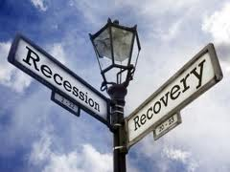
OUR ECONOMY
-A BROAD OVERVIEW –
pictures

Slide 22
OUR ECONOMY
Global Economy
  Recession in global economic growth.
  Overall global growth for 2012 likely to be lower than that recorded during 2011.
South African Economy
  Lower growth in 2012 than in 2011 likely, mainly because of slower growth in household consumption spending.
  Growing unemployment.
  Expected increases in inflation and pressure on the currency in the short to medium term.

Slide 23
OUR ECONOMY
Continued
Western Cape Economy
  Western Cape economic outlook relatively more positive.
  WC growth expected to remain above the national growth for the foreseeable future.
  Overall, economic growth in WC forecast to average 3.5 % between 2012 and 2017.
Overstrand Municipal Area Economy
  Positive growth in past 5 years.
  Can be described as relatively healthy, with its economic potential surpassing other municipalities in the region.
  Reduced consumer spending on travel and tourism has impacted negatively on the local economy.
  Economy poorly diversified – (Services, catering, construction).

Slide 24
OUR ECONOMY
Continued
  CHALLENGES
  Overstrand’s economy and ecology are inseparable – natural environment is biggest single economic asset.
  Balance between development and conserving the natural environment needs to be clearly established.
  Geographically concentrated high poverty areas.
  High unemployment amongst unskilled and semi-skilled (seasonal).
  Need for a more “regional approach "to economic diversification.

Slide 25
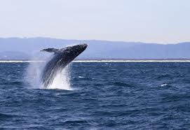
OUR NATURAL ENVIRONMENT
-A BROAD OVERVIEW –

Slide 26
OUR NATURAL ENVIRONMENT
Overstrand Municipal area consists of a diverse range of broad landscape types :
  Sandy coastal plains;
  Sandstone dominated mountain ranges;
  Open valleys;
  Diversity of freshwater and coastal habitats.
Outstanding coastal features:
  Hangklip at Rooi Els;
  Mountainous Kogelberg Biosphere Reserve - recognised as the heart of the Cape Floristic Kingdom.

Slide 27
OUR NATURAL ENVIRONMENT
Continued
Diverse natural vegetative cover, exceeding 65% of the total Overstrand land surface area.
Seven large productive estuaries.
Large network of river corridors /wetlands.
Infestation of invasive alien plant species.
Quality and quantity of fresh water inflows into estuaries.
Impacts of climate change – reduced rainfall.

Slide 28
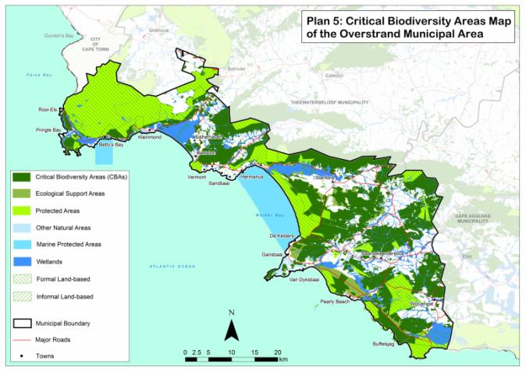
OUR NATURAL ENVIRONMENT
Overstrand Critical Biodiversity and Ecological Support Areas

Slide 29
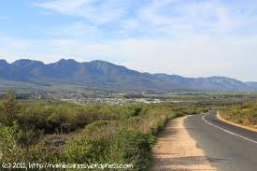
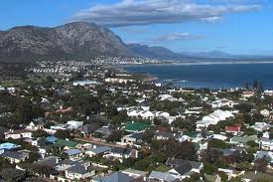
OUR RURAL AND URBAN ENVIRONMENTS
-A BROAD OVERVIEW –

Slide 30
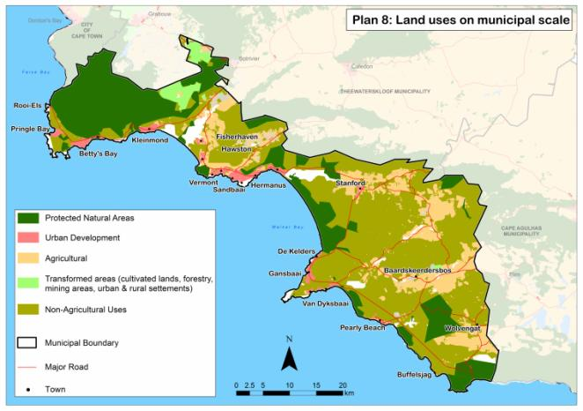
OUR RURAL AND URBAN ENVIRONMENTS
Overstrand Land Uses on Municipal Scale

Slide 31
OUR RURAL AND URBAN ENVIRONMENTS
SPATIAL SETTLEMENT PATTERN
Settlements in the Overstrand Municipal area organised in two main categories - urban nodes and rural settlements.
Urban nodes mainly located in a linear development pattern along the coastal plain.
Low intensity agricultural settlement nodes located further inland.
The distribution pattern of urban nodes and settlements within the municipal area is the result of factors such as:
  Alignment of transport routes;
  Nature of the economic base;
  Population distribution;
  Historic motivation and political decision making.

Slide 32
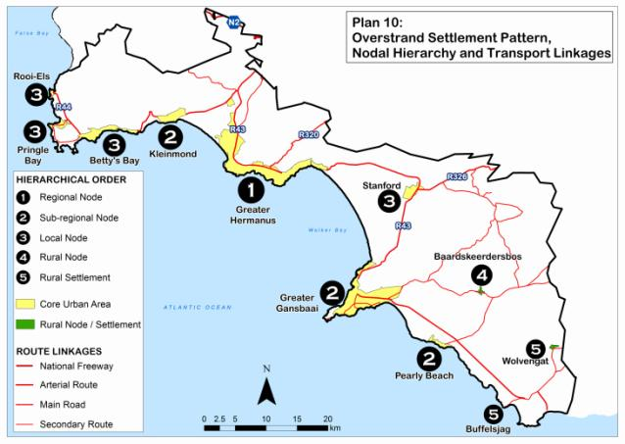
OUR RURAL AND URBAN ENVIRONMENTS
Overstrand Spatial Settlement Pattern – Urban and Rural Settlements

Slide 33
OUR RURAL AND URBAN ENVIRONMENTS
CHALLENGES
Spatial and economic inequalities – high poverty areas.
Decrease in efficiency of urban functions.
Urban sprawl – Densification.
Regional Space Economy.

Slide 34
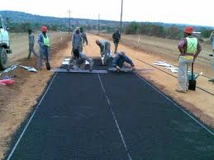
OUR INFRASTRUCTURE
-A BROAD OVERVIEW –

Slide 35
OUR INFRASTRUCTURE
Service infrastructure in this context entails:
  Provision of potable water;
  Treatment of waste water;
  Provision of sanitation facilities ;
  Treatment of sewerage effluent;
  Electricity provision;
  Transport related infrastructure.

Slide 36
OUR INFRASTRUCTURE
Continued
CHALLENGES
Budgetary constraints.
Eliminate backlogs and increase efficiency.
Maintenance and replacement of aging infrastructure.

Slide 37
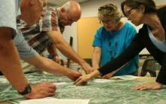
IDENTIFYING ADDITIONAL KEY CHALLENGES AND IMPACTS
REQUESTS FOR INPUTS:
E-mail: wilhelm@udwc.co.za
Identify Key Challenges related to:
    Our People
    Our Economy
    Our Natural Environment
    Our Rural and Urban Environments
    Our Infrastructure and Facilities
Inputs on any aspects of the IDF process

Slide 38
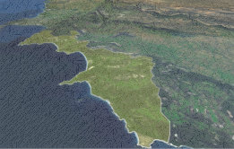
CLOSURE

